Slide 1
Organizational Chart Inference
Speaker: Jim-An Tsai
Advisor: Jia-ling Koh
Author: Jiawei Zhang, Philip S. Yu, Yuanhua Lv
Date: 2016/1/7
Source: KDD’15

Slide 2
Outline
Introduction
Problem Proposed
Method
Experiment
Conclusion

Slide 3
Introduction

Slide 4
Enterprise Social Network

Slide 5
Inference of Organizational Chart

Slide 6
Outline
Introduction
Problem Proposed
Method
Experiment
Conclusion

Slide 7
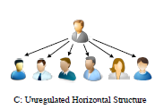
Macro-level

Slide 8
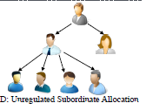
Micro-level

Slide 9
CREATE(Chart Recover)

Slide 10
Outline
Introduction
Problem Proposed
Method
Experiment
Conclusion

Slide 11
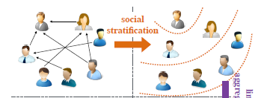
Regulated Social Stratification
Social class

Slide 12
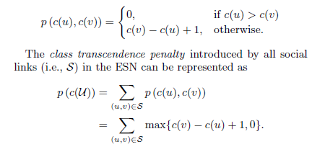
Regulated Social Stratification
Class Transcendence Social Link

Slide 13
Regulated Social Stratification
Matthew Effect based Constraint
Chart Depth Regulation Constraint

Slide 14
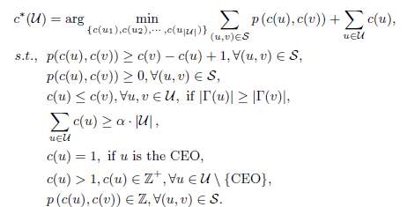
Regulated Social Stratification
Optimal regulated social stratification

Slide 15
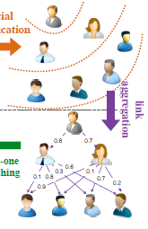
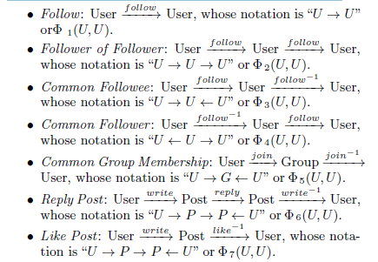
Supervision Link Inference with Social Meta Paths Aggregation
Social Meta Paths in Enterprise Social Networks

Slide 16
Supervision Link Inference
DP-intimacy(Directed Path-Intimacy)
i={1,2,3,4,5,6,7}

Slide 17
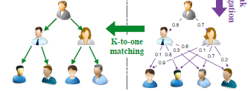
Regulated Social Class Matching

Slide 18
Outline
Introduction
Problem Proposed
Method
Experiment
Conclusion

Slide 19
Experiment Dataset
100k employees

Slide 20
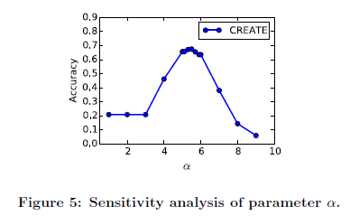
Social Stratification Results
先來實驗出哪個 最佳
= 5.5

Slide 21
Social Stratification Results

Slide 22
Social Stratification Results

Slide 23
Management Threshold Sensitivity Analysis
決定K的值

Slide 24
Organizational Chart Inference Results

Slide 25
Organizational Chart Inference Results

Slide 26
Outline
Introduction
Problem Proposed
Method
Experiment
Conclusion

Slide 27
Conclusion
1. We have studied the organizational chart inference (IOC) problem based on the heterogeneous online ESNs.
2. A new chart inference framework Create has been proposed.

Slide 28
Thanks for Listening

